Slide 1
VRRP LABORATORY
JAHINA AL KHANJARI
26.05.2025

Slide 2
LABORATORY REQUIREMENTS
- Design a network with OSPF routing protocol that has three routers,
R1 and R2 are connected to R3 point-to-point, while R1 and R2 are connected
via a switch.
- Configure R1 and R2 with VRRP Authentication.
- Use VRRP to create virtual gateways for load balancing between R1 and R2.

Slide 3
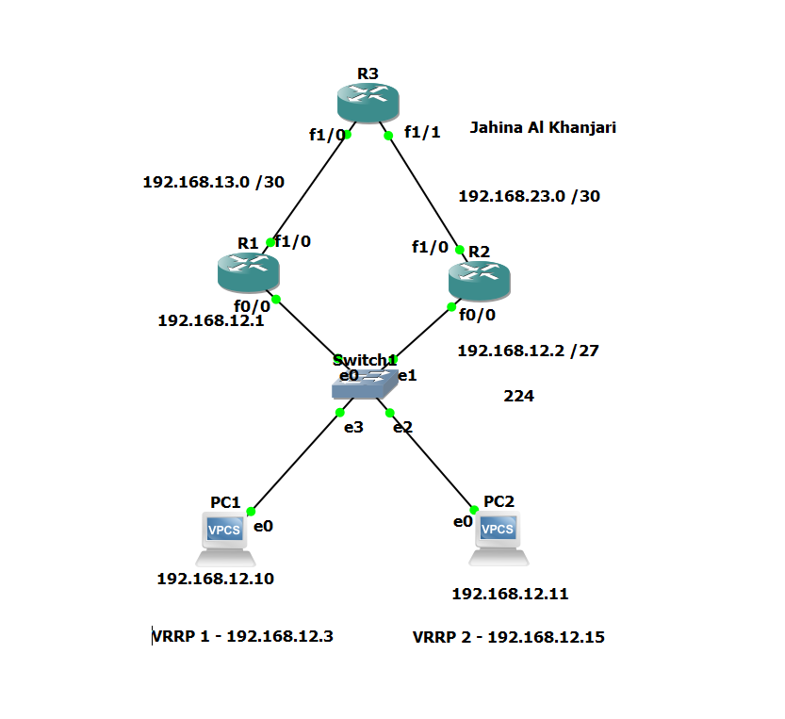
NETWORK DIAGRAM

Slide 4
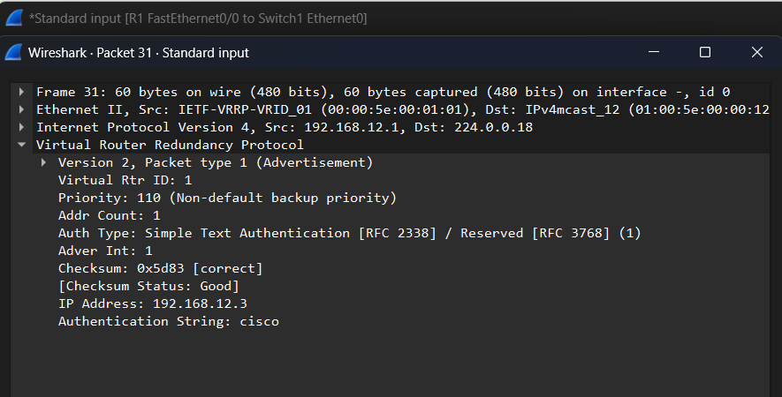
R1 to Switch VRRP Authentication capture

Slide 5
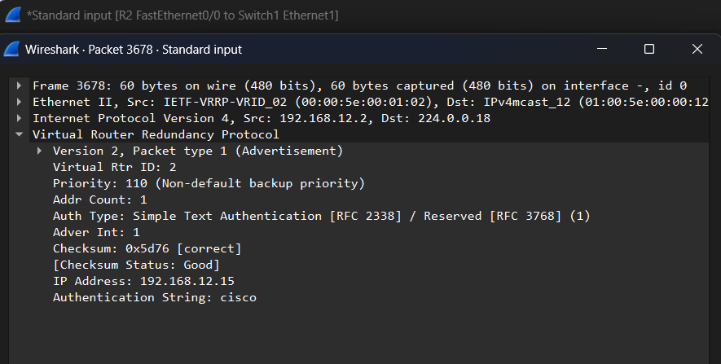
R2 to Switch VRRP Authentication capture

Slide 6
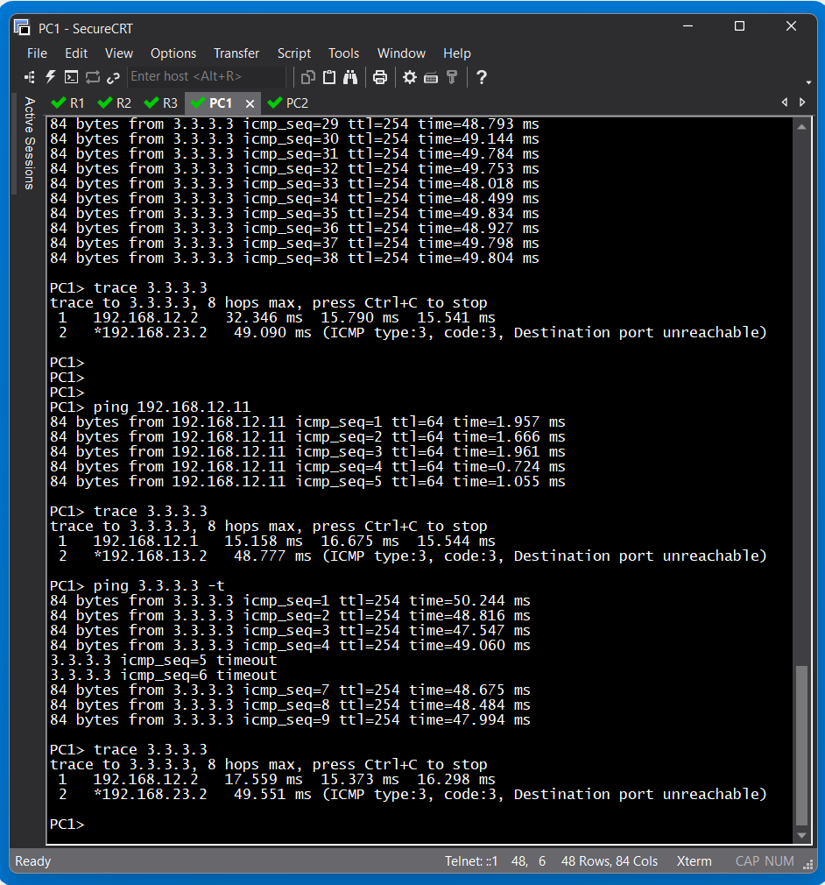
PC1 VRRP TEST
After R1 was suspended
PC1 automatically reached
R3 via R2.

Slide 7
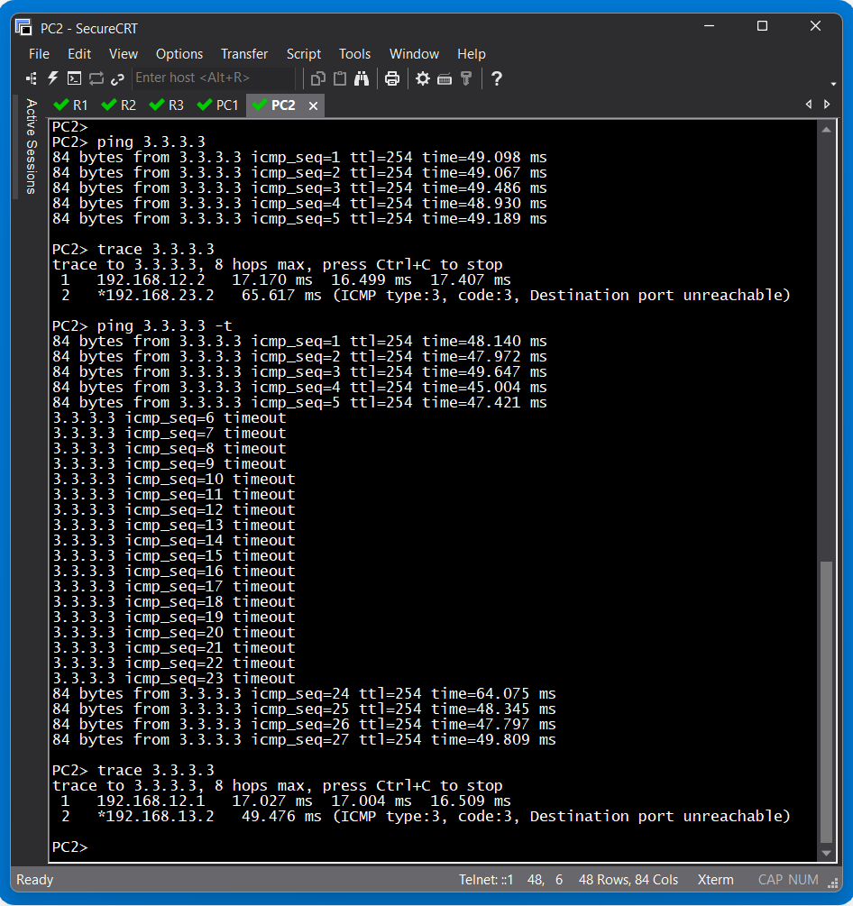
PC2 VRRP TEST
After R2 was suspended
PC2 automatically reached
R3 via R1.

Slide 8
THE END

